Slide 1
Chapter 1 Introduction

Slide 2
教学内容、目标与要求
教学内容
OS发展历程
OS定义
计算机系统组织及结构
OS类型及特点
OS工作模式
OS功能
分布式系统及计算环境
教学重点
2、4、5、6
教学目标与要求
初步了解操作系统，包括操作系统的定义、功能及种类。
理解操作系统的用户态和系统态工作模式。
A1：OS发展
2

Slide 3
Contents
1.1 What Operating Systems Do
1.2 Computer-System Organization
1.3 Computer-System Architecture
1.4 Operating-System Structure
1.5 Operating-System Operations
1.6 Process Management
1.7 Memory Management
1.8 Storage Management
1.9 Protection and Security
1.10 Distributed Systems
1.11 Special-Purpose Systems
1.12 Computing Environments
Concepts, definition
Typical computer system structure
Batch-OS, time-sharing OS
Dual mode operation
Basic functions
Real-time OS
3

Slide 4
1.1 What Operating Systems do?
a program that acts as an intermediary between a user and the computer hardware.
controls the execution of application programs.
an interface between applications/users and hardware.
Operating system’s objectives:
Convenience（方便）
Execute user programs and make solving user problems easier.
Makes the computer system more convenient to use.
Efficiency（效率）
use the computer hardware in an efficient manner.
Ability to evolve（发展）
Permit effective development, testing, and introduction of new system functions without interfering with service.
4

Slide 5
Computer System Components
end user
application programs
programmer
system programs / utilities
operating system
OS designer
hardware
5

Slide 6
1.1.1 User view
Varies according to the interface being used.
Designation goal for different OS
PC -- ease to use, performance
Mainframe, minicomputer -- Maximize resource utilization
Workstation -- Usability and resource utilization
Handheld computer -- Individual usability, touch screen, performance per amount of life
Embedded computer -- Have little or no user view
6

Slide 7
1.1.2 System view
Resource allocator
Manages all resources.
Decides between conflicting requests for efficient and fair resource use.
Control program
controls the execution of user programs and operations of I/O devices, to prevent errors and improper use of the computer.
OS relinquishes(放弃) control of the processor to execute other programs.
7

Slide 8
1.1.3 Defining Operating Systems
No universally accepted definition.
“Everything a vendor ships when you order an operating system” is a good approximation.
But varies wildly
Kernel
OS is the one program running at all times on the computer. (all else being system programs and application programs)
Portion of operating system that is in main memory.
Contains most-frequently used functions.
Also called the nucleus.
8

Slide 9
Defining Operating Systems
政府职能、机制
操作系统是计算机系统中的一个系统软件，
是一些程序模块的集合，
它们能
以尽量有效、合理的方式组织和管理计算机的软硬件资源，
合理地组织计算机的工作流程，控制程序的执行，
向用户提供各种服务功能，
使得
用户能够灵活、方便、有效的使用计算机，
使整个计算机系统能高效地运行。
9

Slide 10



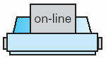
1.2 Computer-System Organization
disk
disk
CPU
disk
controller
USB
controller
graphics
adapter
Memory controller
A2: Types of registers?
Instruction Cycle？
Memory
10

Slide 11
Computer Startup
bootstrap program is loaded at power-up or reboot.
Typically stored in ROM or EEPROM, generally known as firmware.
Initializes all aspects of system.
From CPU registers to device controllers to memory contents.
Locates operating system kernel and loads it into memory, and starts execution.
OS starts executing the first process, such as “init” and waits for some events to occur.
An interrupt from the hardware
Sending a signal to CPU by way of the system bus.
An interrupt from the software
Executing a system call.
11

Slide 12
1.2.1 Computer-System Operation
I/O devices and the CPU can execute concurrently.
Each device controller is in charge of a particular device type.
Each device controller has a local buffer.
CPU moves data from/to main memory to/from local buffers.
I/O is from the device to local buffer of controller.
Device controller informs CPU that it has finished its operation by causing an interrupt.
A3: interrupt?
12

Slide 13
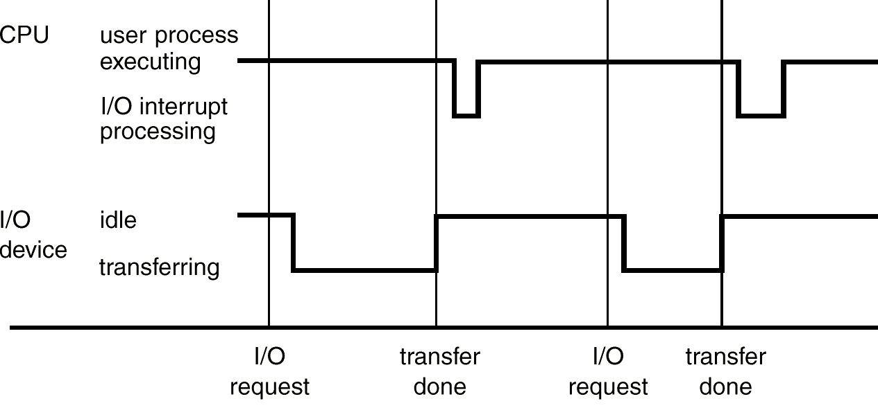
Interrupt Timeline（figure 1.3）
System calls
OS
13

Slide 14
1.2.2 Storage Structure
Main memory -- only large storage area that the processor can access directly.
Secondary storage -- extension of main memory that provides large nonvolatile storage capacity.
Magnetic disks -- rigid metal or glass platters covered with magnetic recording material.
Disk surface is logically divided into tracks, which are subdivided into sectors.
The disk controller determines the logical interaction between the device and the computer.
Magnetic tapes -- used for backup, for storage of infrequently used information.
14

Slide 15
Storage Hierarchy
Storage systems organized in hierarchy.
Speed
Cost
Volatility
Volatile storage loses its contents when the power to the device is removed.
Principle of design a computer memory system：
uses only as much expensive memory as necessary.
provides as much inexpensive, nonvolatile memory as possible.
15

Slide 16
Storage-Device Hierarchy
register
(1) Stores data in a large DRAM array during normal operation, but also contains a hidden Magnetic hard disk and a battery for backup power.
(2) Flash memory, which is popular in cameras and PDAs, in robots, and increasingly for storage on general-purpose computers.
(3) NVRAM (Non-Volatile Random Access Memory), which is DRAM with battery backup power.
cache
main memory
solid-state disk
magnetic disk
optical disk
magnetic tapes
16

Slide 17
1.2.3 I/O Structure
Programmed I/O
Interrupt-Driven I/O
Synchronous I/O
Asynchronous I/O
DMA
I/O通道控制方式
A4: IO结构/方式？
17

Slide 18
I/O operation
device controller
Local buffer storage
A set of special-purpose registers
Moving data between device and its local buffer storage.
device driver
One for each device controller.
Presents a uniform interface to the device.
I/O operation
Device driver loads registers within the controller.
Device controller examines the contents of the registers to determine what action to take.
Device controller starts the transfer of data between the device and its local buffer.
Once done, device controller sets its status , or informs the driver via an interrupt.
Device driver returns control to the OS, with data if ‘read’.
18

Slide 19
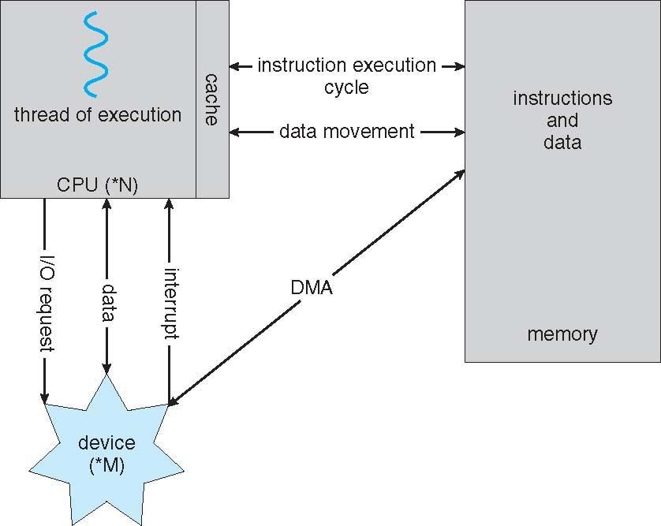
Modern Computer System
high-end systems use switch architecture.
multiple components can talk to other components concurrently, rather than competing for cycles on a shared bus.
19

Slide 20
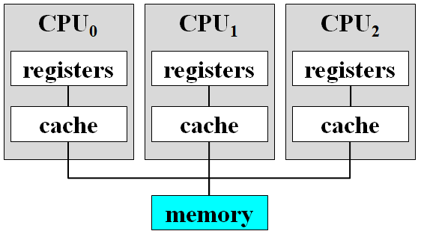
1.3* Computer-System Architecture
Single-processor system
One main CPU executing a general-purpose instruction set
special-purpose processors run a limited instruction set and do not run user processes. Such as:
keyboard and disk controllers
I/O processors (on mainframes)
Multiprocessor system / parallel system
Two or more processors in close communication, sharing the computer bus and the clock, memory and I/O devices.
Advantages
Increased throughput, Economy of scale, Increased reliability
20

Slide 21
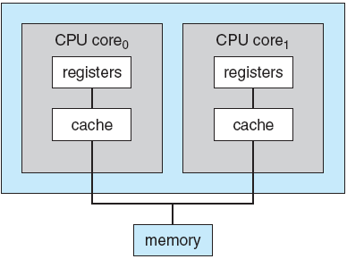
Computer-System Architecture
Multiprocessor system(Cont.)
Asymmetric (非对称的) multiprocessing
Each processor is assigned a specific task.
A boss/ master processor controls the system.
The other slave processors look to the boss for instruction or have predefined tasks.
Boss processor schedules and allocate work to the slave processors.
Symmetric (对称的) multiprocessing -- SMP
Each processor performs all tasks within the OS
All processors are peers
Multi-core CPUs
Multiple compute cores on a single chip
multiprocessor chips
more efficient than multiple chips with single cores.
21

Slide 22
Computer-System Architecture
Multiprocessor system(Cont.)
blade servers (刀片服务器)
multiple processor boards, I/O boards, and networking boards are placed in the same chassis.
each blade-processor board boots independently and runs its own operating system.
Some blade-server boards are multiprocessor as well.
In essence, those servers consist of multiple independent multiprocessor systems.
22

Slide 23
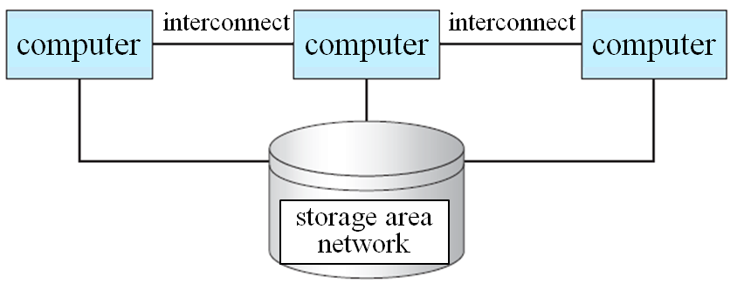
Computer-System Architecture
Clustered (集群) system
Clustered computers share storage and are closely linked via a LAN or a faster interconnect such as InfiniBand.
Used to provide high-availability service.
A layer of cluster software runs on the cluster nodes.
Asymmetric clustering
One machine is in hot-standby mode while the other is running the applications.
The hot-standby host machine does nothing but monitor the active server.
Symmetric clustering
Two or more hosts are running applications and are monitoring each other.
23

Slide 24
1.4 Operating-System Structure
Uniprogramming
Problem: low performance
I/O and CPU could not overlap.
I/O very slow. Processor must wait for I/O instruction to complete before preceding.
solution: off-line I/O operations
loading jobs into memory from tapes.
card reading and line printing done off-line.
CPU
t
0.2ms
I/O
t
Card-Reader 8s
Line printer 10s
24

Slide 25
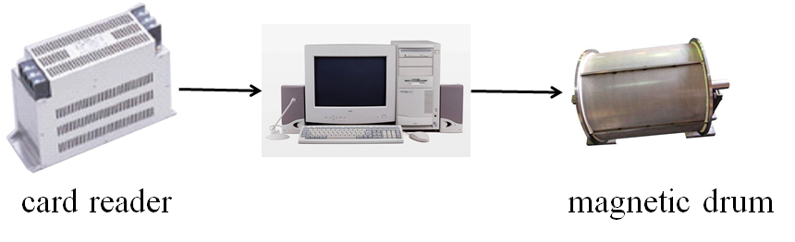
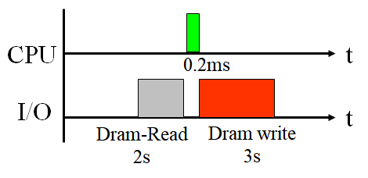
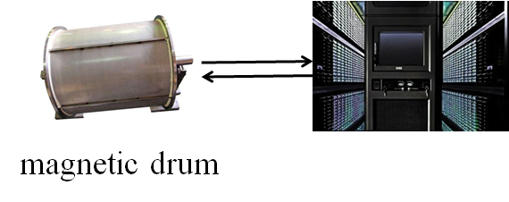
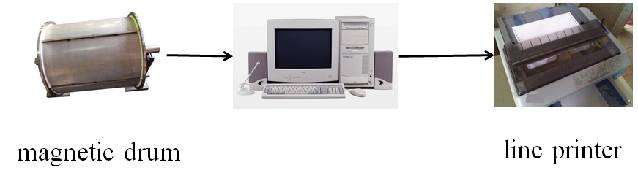
Off-line I/O Operations
(1)
(2)
(3)
Monitor, the OS of batch processing Era.
The 1st, GeneralMotors
2nd, FMS: Fortran Monitor System IBSYS, Monitoring system for IBM 7094
25

Slide 26
Spooling (假脱机)
Simultaneous Peripheral Operation On Line
Overlap I/O operation of one job with computation of another job.
While executing one job, the OS reads next job from card reader into a storage area on the disk (job queue), and outputs printout of previous job from disk to printer.
Job pool
data structure
allows the OS to select which job to run next
to increase CPU utilization
26

Slide 27
Spooling
虚拟设备，提高效率
system/user process
input request
memory
system/user process
output request
card reader
line printer
OS
input process
OS
output process
job pool
27

Slide 28
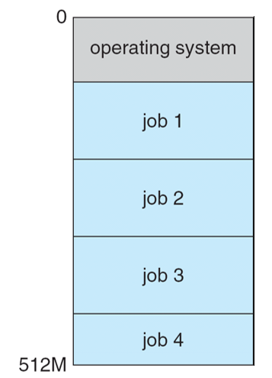
Multiprogramming
To keep CPU and I/O devices busy at all times.
Multiprogramming organizes jobs (code and data) so CPU always has one to execute.
A subset of total jobs in system is kept in memory.
job scheduling – selects one job to run.
When it has to wait ( e.g. for I/O ), OS switches to another job.
28

Slide 29
Multiprogramming
When one job needs to wait for I/O, the processor can switch to the other job.
Multiprogramming with two programs:
Program A
run
I/O
run
I/O
run
Program B
run
I/O
run
I/O
run
A
B
A
B
A
B
combined
time
29

Slide 30
Multiprogramming
Multiprogramming with three programs:
Program A
run
I/O
run
I/O
Program B
run
I/O
run
I/O
Program C
run
I/O
run
A
B
C
A
B
C
combined
time
30

Slide 31
Multiprogramming: Example
A computer: 256KB user memory space, a disk, a terminal, and a printer
 | Job1 | Job2 | Job3
Type of job | Heavy compute | Heavy I/O | Heavy I/O
Duration | 5 min. | 15 min. | 10 min.
Memory required | 50K | 100K | 80K
Need disk? | No | No | Yes
Need terminal? | No | Yes | No
Need printer? | No | No | Yes
31

Slide 32
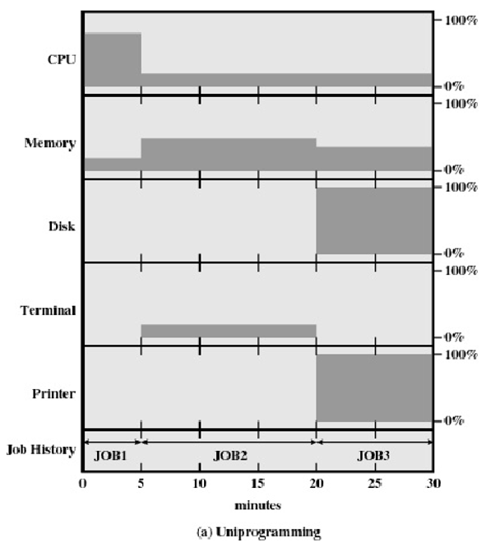
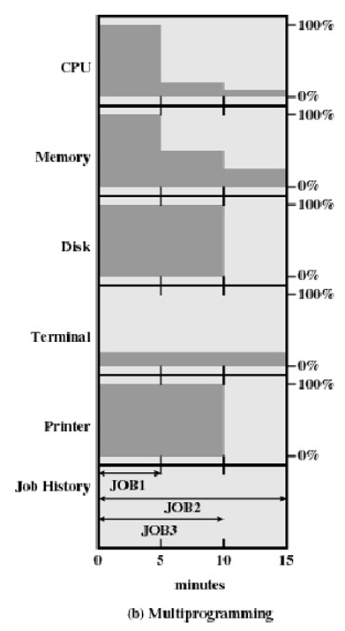
Example: Utilization
系统的吞吐量？
科学技术就是生产力！
32

Slide 33
Time sharing systems
Time sharing (multitasking) is a logical extension, in which CPU switches jobs so frequently that users can interact with each program while it is running, creating interactive computing.
Response time should be less than 1 second.
Each user has at least one program executing in memory ==> process
If several jobs ready to run at the same time ==> CPU scheduling
If processes don’t fit in memory, swapping moves them in and out to run ==> swapper
allows execution of processes not completely in memory ==> Virtual memory
Using multiprogramming to handle multiple interactive jobs.
33

Slide 34
Time sharing systems
The CPU is multiplexed (复用) among several jobs that are kept in memory and on disk.
Processor’s time is shared among multiple users.
The CPU is allocated to a job only if the job is in memory.
A job may be swapped in and out of memory to the disk.
Many users share the computer simultaneously.
On-line communication between the user and the system is provided.
Multiple users simultaneously access the system through terminals.
when the operating system finishes the execution of one command, it seeks the next “control statement” not from a card reader, but rather from the user’s keyboard.
On-line system must be available for users to access data and code.
34

Slide 35
Time sharing systems: Features
I/O routines supplied by the system.
Memory management – the system must allocate the memory to several jobs.
Virtual memory – allows the execution of job not be completely in memory.
Disk management – file system must be provided, which resides on a collection of disks.
CPU scheduling – mechanisms for concurrent execution, job synchronization and communication, avoiding deadlock.
Allocation of resources.
35

Slide 36
Time sharing systems
CTSS
The 1st , 1961, MIT, Compatible Time Sharing System.
For IBM 709, later ported to IBM 7094.
MULTICS
MULTiplexed Information and Computing System
1964, Bell Labs, MIT and GE co participated in R & D.
New ideas: layered file system, shell, process
UNIX
Multi-user & multi-task time sharing OS
1969, UNICS (UNiplexed Information and Computing System), Ken Thompson & Dennis Ritchie, Bell Labs.
1970, UNIX, named by Brian Kernighan.
1971, C language, Ken Thompson & Dennis Ritchie.
1973, rewriting UNIX with C language.
1974, UNIX Officially released
36

Slide 37
Time sharing systems
POSIX: Portable Operating System Interface, IEEE
Standard
C language interface of system call, shell program and tools, thread and network programming, …
Richard M. Stallman
1983, GNU, GNU's Not Unix!
1985, Richard Stallman founded the FSF (Free Software Foundation) to provide technology for the GNU program.
Linux
1991, developed by Linus Torvalds, based on MINIX.
Open Source
1994.3, Linux 1.0
Two mainstream series
Debian: Ubuntu
Red Hat: Fedora, CentOS,
MS-DOS & Windows
MS-DOS, Single user single task OS.
1985, GUI, renamed to Windows.
37

Slide 38
Time sharing systems
iOS
Released in 2007, Apple.
Unix, Non open source
Android
2008.9, Google.
Linux, open source
Designed specifically for touch screen mobile devices
HarmonyOS
38

Slide 39
1.5 Operating-System Operations
Modern operating systems are interrupt driven.
Interrupt driven by hardware
Software error or request creates exception or trap
Division by zero, request for operating system service
Other process problems include infinite loop, processes modifying each other or the operating system
Dual-mode operation allows OS to protect itself and other system components.
Provide hardware support to differentiate between at least two modes of operations.
1. User mode – execution done on behalf of a user.
2. Monitor mode (also kernel mode, system mode, or privileged mode) – execution done on behalf of operating system.
39

Slide 40
Dual-Mode Operation
Dual-mode operation (Cont.)
Mode bit provided by hardware
kernel mode (0) or user mode (1)
Provides ability to distinguish when system is running user code or kernel code.
Some instructions are designated as privileged, only executable in kernel mode.
System call changes mode to kernel mode, return from call resets it to user mode.
When an interrupt or fault occurs hardware switches to kernel mode.
Interrupt/fault
Kernel
mode
User
mode
set user mode
40

Slide 41
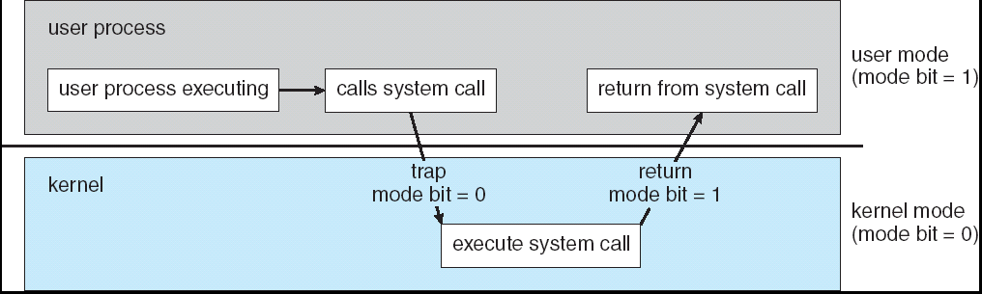
Transition from User to Kernel Mode
Timer to prevent infinite loop/process hogging resources
Set interrupt after specific period
OS decrements counter
When counter zero generate an interrupt
Set up before scheduling process to regain control or terminate program that exceeds allotted time.
Instructions that modify the content of the timer are privileged.
41

Slide 42
1.6 Process Management
A process is a program in execution, is the unit of work within the system. The entity that can be assigned to and executed on a processor.
Process needs resources to accomplish its task.
Process termination requires reclaim(归还) of any reusable resources.
Single-threaded process has one program counter specifying location of next instruction to execute.
Multi-threaded process has one PC per thread.
system has many processes running concurrently on one or more CPUs
by multiplexing the CPU among the processes / threads.
42

Slide 43
Process Management Activities
The OS is responsible for the following activities in connection with process management:
Creating and deleting both user and system processes
Suspending and resuming processes
Providing mechanisms for process synchronization
Providing mechanisms for process communication
Providing mechanisms for deadlock handling
43

Slide 44
1.7 Memory Management
Central to the operation of a modern computer system.
All data should be in memory before and after processing.
All instructions should be in memory in order to execute.
The only large storage device that CPU is able to address and access directly.
Memory management determines what is in memory
To improve the CPU utilization and the speed of the computer's response to users.
Memory management activities
Keeping track of which parts of memory are currently being used and by whom.
Deciding which processes (or parts thereof) and data to move into and out of memory.
Allocating and deallocating memory space as needed.
44

Slide 45
1.8 Storage Management
OS provides a uniform, logical view of information storage.
Abstracts from the physical properties to define a logical storage unit - file.
Each medium is controlled by a device (such as disk drive, tape drive)
Varying properties include access speed, capacity, data-transfer rate, access method (sequential or random)
45

Slide 46
File-System management
Files usually organized into directories.
Access control on most systems to determine who can access what.
OS activities include:
Creating and deleting files
Creating and deleting directories to organize files
Supporting primitives (原语) for manipulating files and directories
Mapping files onto secondary storage
Backing up files onto stable (nonvolatile) storage media
46

Slide 47
Mass-Storage Management
Usually disk is used to store data that does not fit in main memory or data that must be kept for a “long” period of time.
The proper management of disk is of central importance.
OS activities
Free-space management
Storage allocation
Disk scheduling
Entire speed of computer operation hinges on disk subsystem and its algorithms.
Some storage need not be fast
Tertiary storage includes optical platters, magnetic tape
Varies between WORM (write-once, read-many-times) and RW.
not crucial to system performance, but still must be managed.
mounting and unmounting, allocating and freeing
migrating data from secondary to tertiary storage
47

Slide 48
Caching
Important principle, performed at many levels in a computer (in hardware, operating system, software)
Information in use copied from slower to faster storage temporarily.
Caching – copying information into faster storage system; main memory can be viewed as a last cache for secondary storage.
cache checked first to determine if information is there
If it is, information used directly from the cache (fast)
If not, data copied to cache and used there
Cache smaller than storage being cached
Cache management policy is an important design problem.
Cache size and replacement policy
48

Slide 49
Disk Cache
Cache Memory
A portion of main memory used as a buffer to temporarily to hold data for the disk.
Disk writes are clustered (簇)
Some data written out may be referenced again. The data are retrieved rapidly from the software cache instead of slowly from disk.
Invisible to operating system
Increase the speed of memory
Processor speed is faster than memory speed
49

Slide 50
Performance of Various Levels of Storage
Movement between levels of storage hierarchy can be explicit or implicit.
50

Slide 51
Coherency and Consistency
The same data may appear in different levels of the storage system.
Update integer A, migration of A from disk to register:
Computing environment
single processor environment ---- only one process executes at a time
single processor environment ---- multitasking environment
multiprocessor environment ---- cache coherency
distributed environment
magnetic
disk
A
main
memory
A
cache
A
CPU
register
51

Slide 52
I/O Subsystem
One purpose of OS is to hide peculiarities(特性) of hardware devices from the user.
I/O subsystem responsible for
Memory management of I/O， including
buffering (storing data temporarily while it is being transferred)
caching (storing parts of data in faster storage for performance)
spooling (the overlapping of output of one job with input of other jobs)
General device-driver interface
Drivers for specific hardware devices
52

Slide 53
1.9 Protection and Security
Protection – any mechanism for controlling access of processes or users to resources defined by the OS.
Security – defense of the system against internal and external attacks.
Huge range, including denial-of-service, worms, viruses, identity theft, theft of service
Access control
regulate user access to the system
Information flow control
regulate flow of data within the system and its delivery to users
Certification
proving that access and flow control perform according to specifications
53

Slide 54
Protection and Security
Systems generally first distinguish among users, to determine who can do what.
User identities (user IDs, security IDs) include name and associated number, one per user.
User ID then associated with all files, processes of that user to determine access control.
Group identifier (group ID) allows set of users to be defined and controls managed, then also associated with each process, file.
Privilege escalation allows user to change to effective ID with more rights.
系统安全
数据安全
IT基础设施安全
A5: 核心技术自主可控！
54

Slide 55
1.10* Distributed Systems
Distribute the computation among several physical processors.
Loosely coupled system -- distributed system
Each processor has its own local memory.
Processors communicate with one another through network.
Advantages of distributed systems:
Resources Sharing
Computation speed up – load sharing
Reliability
Communications
55

Slide 56
Distributed Systems
Collection of separate, possibly heterogeneous, systems networked together
Network is a communications path,
Protocols, TCP/IP most common
Distances between nodes
Local Area Network (LAN), Wide Area Network (WAN)
Metropolitan Area Network (MAN), Personal Area Network (PAN)
Transport media
Copper wires, fiber strands, wireless transmissions between satellites, microwave dishes, and radios.
May be either client-server or peer-to-peer systems.
Network Operating System provides features between systems across network.
Communication scheme allows systems to exchange messages.
56

Slide 57
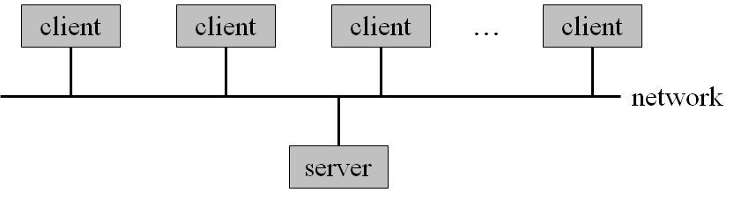
Distributed Systems
Client-server structure:
Network Operating System
provides file sharing across the network.
provides communication scheme allowing different processes on different computers to exchange messages.
runs independently from other computers on the network.
Distributed Operating System
less autonomy between computers
gives the impression there is a single operating system controlling the network.
Process migration
57

Slide 58
1.11 Special-Purpose Systems
Real-time systems
Real-time embedded systems
Multimedia systems
Handheld systems
58

Slide 59
Real-Time Systems
Used when there are rigid time requirements on the operation of a processor or the flow of data.
Often used as a control device in a dedicated application, such as controlling scientific experiments, medical imaging systems, industrial control systems, and some display systems.
Has well-defined fixed time constraints. Processing must be done within the defined constraints, or the system will fail.
There are two classes of real-time systems
hard real-time system
soft real-time system.
59

Slide 60
Real-Time Systems
Hard real-time system
goal: to guarantee critical tasks be completed on time.
Secondary storage limited or absent, data stored in short-term memory, or read-only memory (ROM)
Conflicts with time-sharing systems, not supported by general-purpose operating systems.
Soft real-time system
a critical real-time task gets priority over other tasks, and retains that priority until it completes.
Lack of deadline support, limited utility in industrial control or robotics.
Useful in applications (multimedia, virtual reality, scientific projects) requiring advanced operating-system features.
60

Slide 61
Real-Time embedded systems(*)
The OS provide limited features
Has very specific tasks.
Has little or no user interface.
Preferring to spend their time monitoring and managing hardware devices, such as automobile engines and robotic arms.
Implementation
General-purpose computers with special-purpose applications.
Hardware devices with a special-purpose embedded OS.
Hardware devices with application-specific integrated circuits that perform their tasks without an OS.
Typical representative：
VxWorks, 1983, WRS(Wind River System)
61

Slide 62
Others (*)
* Handheld systems
Embedded systems
Multimedia systems
Handheld systems
Personal Digital Assistants (PDAs)
Palm and Pocked-PCs and cellular telephones
Use special-purpose embedded OS
Issues:
Limited memory size
Slow processors a faster processor would require a larger battery, which would take up more space and would have to be replaced (or recharged) more frequently.
Small display screens.
iOS
Released in 2007.1.9, Apple.
Unix, Non open source
Android
Google, 2007.11.5 release
2008.9, open source
Linux
Designed specifically for touch screen mobile devices
HarmonyOS
62

Slide 63
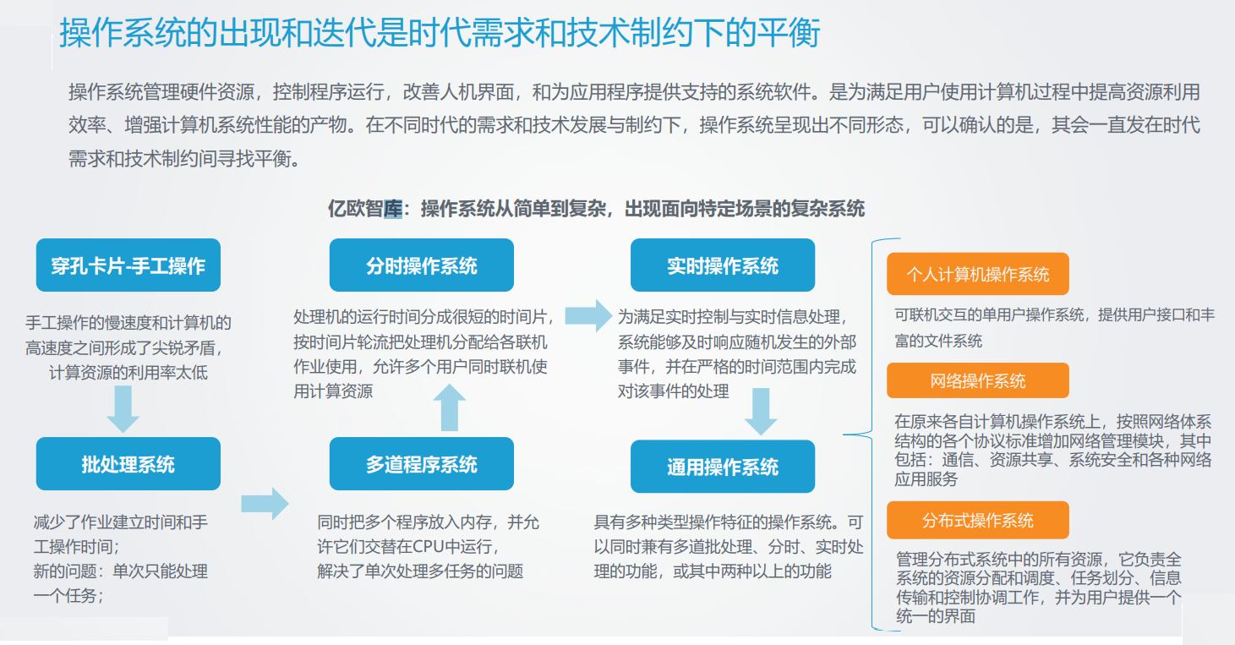
操作系统的发展：需求驱动+技术制约
万物互联时代的操作系统研究报告.pptx-原创力文档 (book118.com)
63

Slide 64
1.12* Computing Environments
Traditional computing
Typical office environment
PCs connected to a network, servers providing file and print services. Remote access was awkward, portability was achieved by use of laptop computers.
Terminals attached to mainframes were prevalent at many companies as well, with even fewer remote access and portability options.
Portals provide web access to internal systems.
Network computers (thin clients) are like Web terminals
Mobile computers interconnect via wireless networks
Networking becoming ubiquitous – even home systems use firewalls to protect home computers from Internet attacks.
64

Slide 65
Computing Environments
Mobile Computing
Handheld smartphones, tablets, etc
What is the functional difference between them and a “traditional” laptop?
screen size, memory capacity
Extra feature – more OS features (GPS, gyroscope)
Allows new types of apps like augmented reality
Use IEEE 802.11 wireless, or cellular data networks for connectivity
Leaders are Apple iOS and Google Android
65

Slide 66
Computing Environments
Client-Server Computing
Terminals connected to centralized systems are now being supplanted by smart PCs.
Many systems now servers, responding to requests generated by clients.
Server systems
Compute-server system provides an interface to client to request services (i.e., database server)
File-server system provides interface for clients to store and retrieve files (exp. web server)
66

Slide 67
Computing Environments
Peer-to-Peer Computing
P2P does not distinguish clients and servers
all nodes are considered peers
May each act as client, server or both
Node must join P2P network
Registers its service with centralized lookup service on network, or
Broadcast request for service and respond to requests for service via discovery protocol
Examples:
Napster, Gnutella
Voice over IP (VoIP) such as Skype uses a hybrid peer-to-peer approach
67

Slide 68
Computing Environments
Cloud computing*
Delivers computing, storage, even apps as a service across a network
Logical extension of virtualization because it uses virtualization as the base for it functionality.
Amazon EC2(Elastic Compute Cloud) has thousands of servers, millions of virtual machines, of storage available across the Internet, pay based on usage
Many types
Public cloud – available via Internet to anyone willing to pay
Private cloud – run by a company for the company’s own use
Hybrid cloud – includes both public and private cloud components
Software as a Service (SaaS) – one or more applications available via the Internet (i.e., word processor)
Platform as a Service (PaaS) – software stack ready for application use via the Internet (i.e., a database server)
Infrastructure as a Service (IaaS) – servers or storage available over Internet (i.e., storage available for backup use)
68

Slide 69
Computing Environments
Cloud computing*(Cont.)
Cloud computing environments composed of traditional OSes, plus VMMs, plus cloud management tools.
Internet connectivity requires security like firewalls
Load balancers spread traffic across multiple applications
E.g. a public cloud providing IaaS
A6: 移动计算的基础：移动通信网络
69

Slide 70

课后作业及研究性学习
作业：掌握各种类型操作系统的基本特点
实验：动手安装操作系统实验环境
调研：了解操作系统的发展历史
70

Slide 71
A1：操作系统发展
系统软件, 计算机系统的灵魂
OS的发展
华为在 Linux kernel 5.1中的贡献
国产OS代表
openEuler
国内流行的手机OS
71

Slide 72
OS的发展
操作系统诞生：盘古开天地
GM-NAA I/O，1956年，IBM/704大型机，Bob Patrick，批
CP/M，1974年，微机操作系统， Gary Kildall(加里·基尔代尔)，DRI(Digital Research, Inc.)，8位机，1974~1980
DOS：操作系统远古霸主（1981-1994）
86-DOS，1980年，Tim Paterson，Seattle Computer Products，基于CP/M，1981.4， 推出86-DOSv1.0
1981.7，Bill Gates，50K$，买断86-DOS，更名为： MS-DOS
DOS家族：MS-DOS、PC-DOS、DR-DOS、Free-DOS、PTS-DOS、ROM-DOS、JM-OS等 MS-DOS最为著名，Free-DOS最自由开放
随着Windows的推出，DOS以命令行的形式存在于系统中
PC操作系统全接触_科技时代_新浪网 (sina.com.cn)

Slide 73
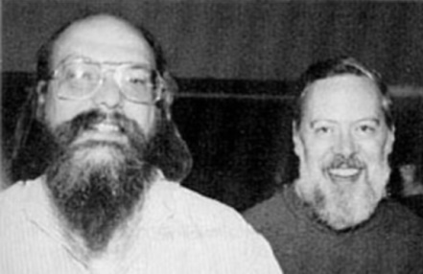
OS的发展
Windows：操作系统当代大亨
1985.11，推出Windows 1.0
最初的Windows 3.0系统，运行在DOS下的一种16位应用程序
win11
Unix：商用
分时OS，1969年在AT&T Bell实验室诞生， Ken Thompson，Dennis Ritchie，1983年，图灵奖
1971-1972，Dennis Ritchie开发C语言， 1973年，用C改写原来用汇编语言编写的Unix，由此产生了Unix V5。
1978年，Unix V6发表，1979年用于超级小型机VAX-11
从1979年Unix V7开始，Unix的许可证开始禁止大学使用Unix的源码，包括在授课中学习。

Slide 74

OS的发展
Linux：
1991.10.5 发布， Linus Benedict Torvalds，芬兰赫尔辛基大学计算机系。
目的：替代Minix操作系统
教学，1987年，Andrew S. Tanenbaum，荷兰阿姆斯特丹的Vrije大学计算机科学系教授。
GNU/Linux，1992年，免费使用和自由传播的类Unix系统 源代码免费开放
GNU：GNU's Not UNIX 的递归缩写
GNU计划：自由软件集体协作计划
在GPL(General Public License)保护下的自由软件
软件版权保护
开发者许可。复制，发布和修改这些软件的法律许可
团队合作，
开发共享，
有序、标准化

Slide 75







OS的发展
FreeBSD：
Unix的两大主流： BSD Unix，Unix System V。 以后的Unix系统都是这两种系统的衍生产品。
运行在x86平台下的类Unix系统
发展始于1993年，起源于386 BSD Unix，加州大学伯克利分校
为不同架构的计算机系统提供了不同程度的支持
主要应用于网络服务器端。

Slide 76


OS的发展
BeOS：
多媒体操作系统，Be.Inc公司
1996.11，发布第一个运行于苹果机上的版本 1998年，发布第一个运行于Intel平台的版本 2000年发布5.0版本： 个人版(BeOS 5.0 Personal Edition)/免费， 专业版(BeOS 5.0 Professional Edition)， 官方最后版本是5.03版。
2001.8，Be公司被palm公司以1100万收购
由BeOS衍生出来的其它非官方版本仍然在继续发展，如商业的Zeta BeOS和开源的Haiku (OpenBeOS ) 。

Slide 77
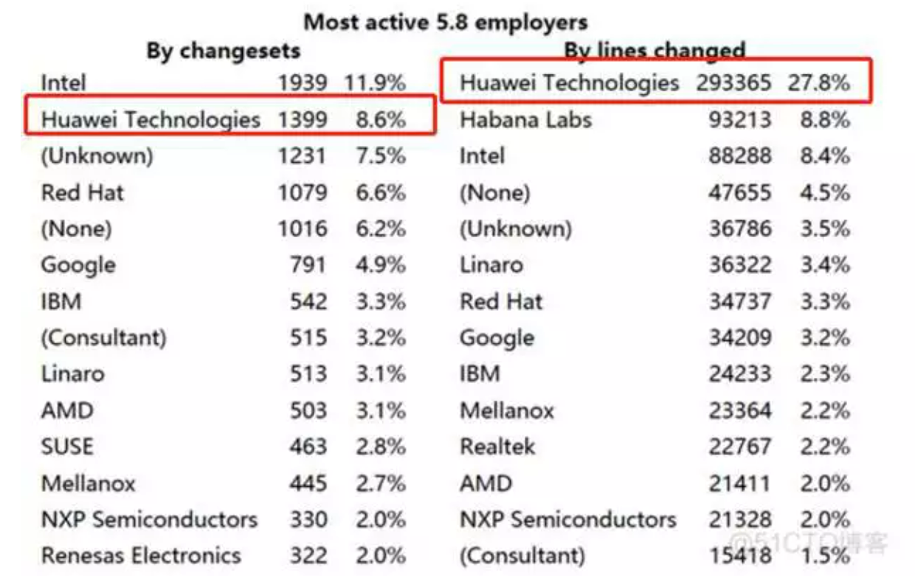
华为，Linux kernel 5.8 最大的贡献者 （2022.7）
代码修改行 (line changed)位列第一，占比27.8%，是第二名的3倍以上；
代码贡献(changesets)位列第二名，占比8.6%，仅次于Intel。

Slide 78
华为开发者贡献Linux内核补丁
2022年12月
Linux 6.2 近日合并了一个重要补丁， 该补丁能够将一个核心内核函数速度提升 715 倍。
Zhen Lei，贡献此补丁的维护者，来自华为。
将 kallsyms_lookup_name () 的平均查找性能提高了 715 倍
使内核里面旧实现的时间复杂度从 O (n) 升级到 O (log (n))，大幅减少查找时间
还保留了 /proc/kallsyms 上旧的实现支持。
kallsyms_lookup_name () 函数用于根据名称查找符号的地址，并可用于查找内核符号表中的任何符号。

Slide 79
国产OS代表
中标麒麟国产OS
2003年推出，中标软件（中国）设计
用户量：5000万左右（主要用户政府机构）
Alios 操作系统
2018年推出，阿里
以驱动万物智能为目标
Huawei HarmonyOS
2019年8月推出，华为
基于微内核的面向全场景的分布式操作系统
UOS， “UnionTech OS”
由统信软件开发的一款基于Linux内核的操作系统
2020年8月12，发布UOS 桌面操作系统 V20 专业版
华为台式机 自研CPU+UOS2.0

Slide 80

openEuler 出现的背景
EulerOS是一款基于Linux内核的服务器操作系统，支持x86和ARM等多种处理器架构，适用于数据库、大数据、云计算、人工智能等应用场景；
10余年的发展中，EulerOS成功支持了华为各种产品解决方案，以安全、稳定、高效被业界认可；
随着云计算的兴起和鲲鹏芯片的发展，EulerOS成为与鲲鹏芯片配套最合适的软件基础设施；
为推动鲲鹏生态的发展，繁荣国内和全球的计算产业，2019年底EulerOS被正式推送开源社区，命名为openEuler 。

Slide 81
OpenEuler发展历程
2010
2013
2013-2016：EulerOS 1.x 开始在华为企业存储、无线控制器、Cloud Edge等产品上应用
高性能计算项目立项。
2016
昆仑32路高端服务器，竞争力业界领先；
业界首款ARM芯片的企业级存储，成本下降25% 。
落地存储全系列产品、无线控制器、Cloud Edge管理面
国内金融联合创新项目
2018
上线德电、法电、西班牙电信、华为云等；
ARM64版本落地华为云数据中心。
2019
openEuler社区运营；
EulerOS开源。
2016-2019：EulerOS 2.x 开始在华为消费者云、公有云/私有云、NFV、分布式存储、服务器、云核心网解决方案中应用。

Slide 82
OpenEuler和主流OS系的关系
Linux Kernel
openEuler与SuSE、Debian、RedHat的上游社区都是kernel社区 www.kernel.org
openEuler社区发行LTS免费版本，使能OSV发展商业发行版，如麒麟软件、普华、中科软、万里开源等
社区版
红帽
fedora
商用版
免费版
RHEL
CentOS
Debian
ubuntu
商用版
SLES
SuSE
免费版
OpenSuSE
麒麟V10
openEuler
社区
免费版
商用版
openEuler
iSoft V5.1
EulixOS 1.0

Slide 83
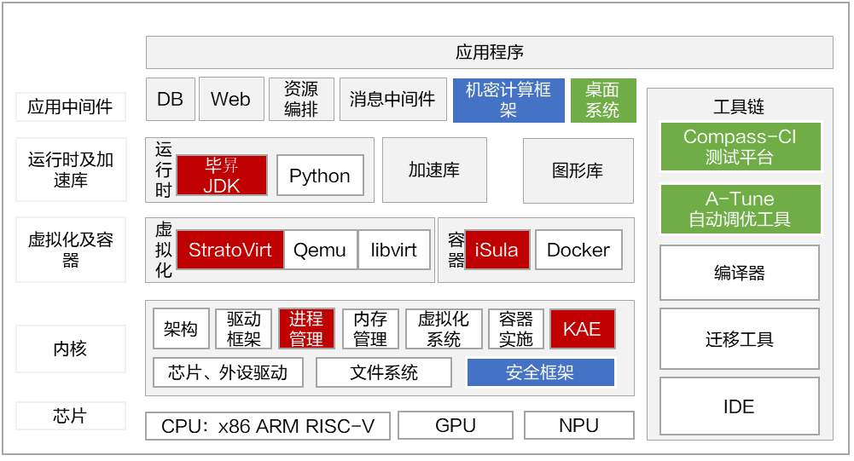
OpenEuler平台框架
释放算力：
Kernel：分预调 +15%
StratoVirt轻量级虚拟机： 开销 -80%， 启动速度 +10倍
iSula 2.0云原生容器： 空载资源消耗 -68%
毕昇JDK：SpecJbb +20%
繁荣生态：
Compass-CI 开源软件自动化测试平台： 1000+开源软件自动化测试
A-Tune 智能调优： 10 大类场景，20+款应用
UKUI 桌面： 轻量级Linux桌面环境
安全可信：
IMA 完整性度量架构：防止恶意篡改
secGear 机密计算框架：多平台安全应用开发效率倍级提升

Slide 84
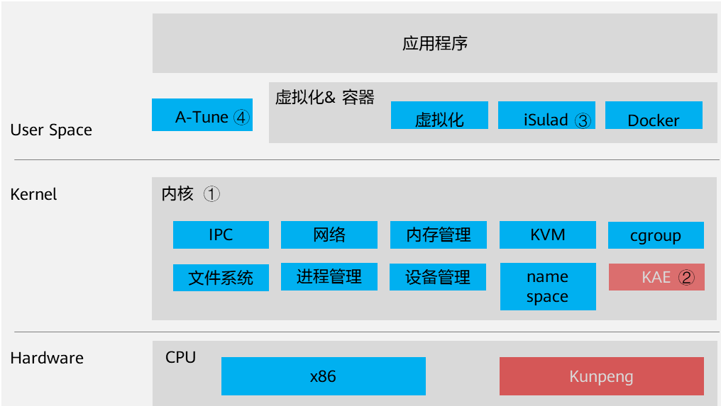
OpenEuler的增强
openEuler所做的增强包含了如下几个方面：
多核调度技术：Numa aware解决方案
软硬件协同：提供KAE（Kunpeng Accelerator Engine）引擎插件
轻量级虚拟化：提供iSulad轻量级容器全场景解决方案
智能优化引擎：A-Tune

Slide 85
国内流行的手机OS
iOS
Android
HarmonyOS
小米操作系统（MIUI）
vivo 的Hi-Fi& Smart （Funtouch OS）
魅族操作系统（flyme OS）
锤子操作系统（ Smartisan OS）
360 OS
华为操作系统（emui）

Slide 86
A2: Types of registers & Instruction Cycle
Processor Registers
Basic Instruction Cycle
Types of instructions
Example
86

Slide 87
Processor Registers
User-visible registers
Enable programmer to minimize main-memory references by optimizing register use.
Control and status registers
Used by processor to control operating of the processor.
Used by operating-system routines to control the execution of programs.

Slide 88
User-Visible Registers
May be referenced by machine language.
Available to all programs -- application programs and system programs.
Types of registers
Data
Address
Index: involves adding an index to a base value to get an address
Segment pointer: when memory is divided into segments, memory is referenced by a segment and an offset
Stack pointer: points to top of stack.

Slide 89
Control and Status Registers
Program Counter (PC)
Contains the address of an instruction to be fetched.
Instruction Register (IR)
Contains the instruction most recently fetched.
Program Status Word (PSW)
condition codes
Interrupt enable / disable
Kernel ( / Monitor / Supervisor ) mode / user mode
Condition Codes or Flags
Bits set by the processor hardware as a result of operations
Can be accessed by a program but not altered.
Examples
positive result, negative result, zero
Overflow

Slide 90
Basic Instruction Cycle
Fetch next
Instruction
Execute
Instruction
start
Halt
Fetch Cycle
Execute Cycle
The processor fetches the instruction from memory
Fetched instruction is placed in the instruction register.
Program counter (PC) holds address of the instruction to be fetched next.
Program counter is incremented after each fetch.

Slide 91
Types of instructions
How many types?
Processor-memory
transfer data between processor and memory
Processor-I/O
data transferred to or from a peripheral device
Data processing
arithmetic or logic operation on data
Control
alter sequence of execution

Slide 92
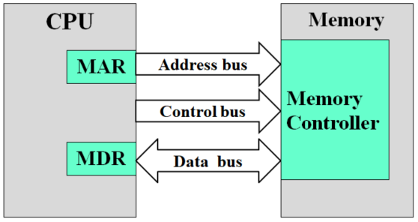
Example of Program Execution
Instruction form
Operate Code
Address
0001: LOAD data from Memory to AC
0010: MOVE data from AC to Memory
0101: ADD data in Memory to AC
Memory
CPU Registers
300
301
PC
302
303
1 9 4 0
300
301
5 9 4 1
0 0 0 3
AC
0 0 0 5
302
2 9 4 1
1 9 4 0
IR
5 9 4 1
2 9 4 1
Example
M1+M2⇒M2
…
3 + 2 = 5
940
0 0 0 3
941
0 0 0 5
0 0 0 2

Slide 93
A3: interrupt
Basic concepts
Classes of Interrupts
Common Functions of Interrupts
Interrupt Handling
Interrupt Cycle
93

Slide 94
Basic Concepts
An interruption of the normal sequence of execution
Improves processing efficiency
Allows the processor to execute other instructions while an I/O operation is in progress
A suspension of a process caused by an event external to that process and performed in such a way that the process can be resumed

Slide 95
Classes of Interrupts
Program
arithmetic overflow
divided by zero
execute illegal instruction
reference outside user’s memory space
Timer
I/O
Hardware failure
A trap is a software-generated interrupt caused either by an error or a user request.
trap
interrupt

Slide 96
Common Functions of Interrupts
Interrupt transfers control to the interrupt service routine generally, through the interrupt vector, which contains the starting addresses of all the service routines.
Interrupt architecture must save the address of the interrupted instruction.
Incoming interrupts are disabled while another interrupt is being processed to prevent a lost interrupt.
An operating system is interrupt driven.

Slide 97
Interrupt Handling
The operating system preserves the state of the CPU by storing registers and the program counter.
Determines which type of interrupt has occurred:
Polling (轮询)
vectored interrupt system
Separate segments of code determine what action should be taken for each type of interrupt.

Slide 98
Interrupt Cycle
Fetch Cycle
Execute Cycle
Interrupt Cycle
Interrupt
disabled
Fetch next
Instruction
Execute
Instruction
Check for
Interrupt;
Process Interrupt
start
Interrupt
Enabled
Halt
Processor checks for interrupts.
If no interrupts, fetch the next instruction for the current program.
If an interrupt is pending, suspend execution of the current program, and execute the interrupt handler.

Slide 99
A4: IO结构&方式
Programmed I/O
Interrupt-Driven I/O
Direct Memory Access
I/O通道控制方式
99

Slide 100
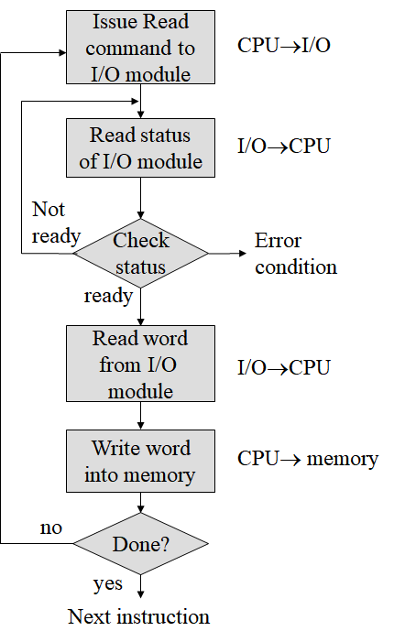
I/O Structure: Programmed I/O
I/O module performs the action, not the processor.
Sets appropriate bits in the I/O status register.
No interrupts occur
Processor checks status until operation is complete.
Read a character:

Slide 101
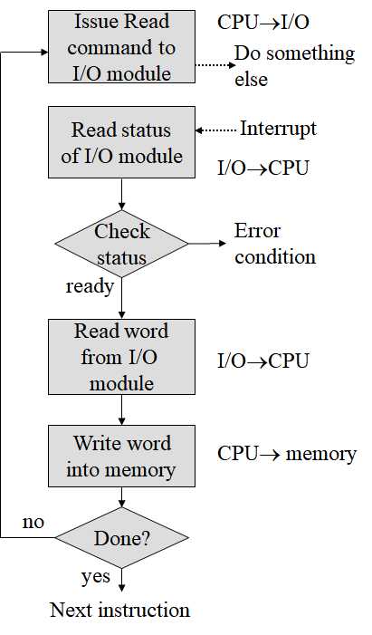
I/O Structure: Interrupt-Driven I/O
Processor is interrupted when I/O module ready to exchange data.
Processor is free to do other work.
No needless waiting
Consumes a lot of processor time because every word read or written passes through the processor.

Slide 102
Interrupt-Driven I/O
Synchronous I/O----After I/O starts, control returns to user program only upon I/O completion.
Asynchronous I/O---- After I/O starts, control returns to user program without waiting for I/O completion.
requesting process
waiting
requesting process
user
device driver
device driver
interrupt handler
interrupt handler
kernel
hardware
data transfer
hardware
data transfer
time
time

Slide 103
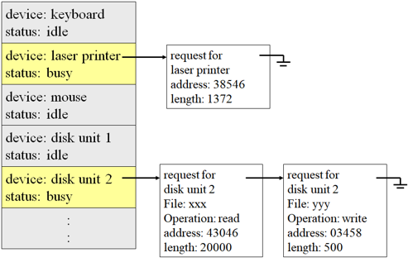
Interrupt-Driven I/O
In order to increase the utilization of CPU and I/O device, we need:
System call -- request to the operating system to allow user to wait for I/O completion.
Device-status table -- contains entry for each I/O device indicating its type, address, and state.
Operating system indexes into I/O device table to determine device status and to modify table entry to include interrupt.

Slide 104
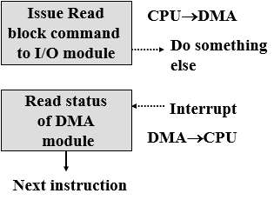
I/O Structure: Direct Memory Access
Transfers a block of data directly to / from memory.
Used for high-speed I/O devices able to transmit information at close to memory speeds.
After setting up buffers, pointers, and counters for the I/O devices , device controller transfers blocks of data from buffer storage directly to main memory without CPU intervention.
Only one interrupt is generated per block.
An interrupt is sent when the task is complete.
The processor is only involved at the beginning and the end of the transfer.
CPU is available to accomplish other work while the device controller is performing the DMA transfer.

Slide 105
I/O Structure: I/O通道控制方式
是DMA方式的发展，进一步减少了CPU的干预。
完成一组数据块的读(或写)操作之后产生一次中断。
实现了CPU、通道和I/O设备三者的并行操作。
CPU对通道的管理是通过I/O指令实现的。
I/O指令属于特权指令，仅能由操作系统使用。
在I/O指令中需指定通道号、设备号、以及通道程序的内存地址。
当CPU要完成一组相关的读(或写)操作及有关控制时，只需向I/O通道发送一条I/O指令，以给出其所要执行的通道程序的首址和要访问的I/O设备，通道接到该指令后，通过执行通道程序便可完成CPU指定的I/O任务。

Slide 106
I/O通道控制方式：通道指令
通道指令也称为通道命令字(CCW, Channel Command Word)
对设备进行初始化、读、写、查询、转移等。
使用CCW可以编写对各种不同设备进行管理和控制的通道程序。
一个通道可以以分时方式同时执行几个通道程序。
通道指令在进程要求数据时自动生成。
指令格式： OP P R 计数 内存地址
OP：读、写、或控制。
P：通道程序结束标志。P='1'，本条指令为最后一条指令。
R：记录结束标志。 R='0'，本指令与下一条指令所处理的数据属于同一条记录 R='1'，本指令是处理某记录的最后一条指令。
计数：本条指令所要处理数据的字节数
内存地址： 读操作：数据要写入的内存地址。 写操作：要写出的数据在内存中的起始地址。

Slide 107
I/O通道控制方式：通道程序举例
OP P R 计数 内存地址
read 0 0 250 1850 read 1 1 250 720
OP P R 计数 内存地址
write 0 0 80 813 write 0 0 140 1034 write 0 1 60 5830 write 0 1 300 2000 write 0 0 200 1650 write 1 1 300 2720

Slide 108
A5: 安全--中国故事
核心技术自主可控
典型事件
美国制裁
思考与应对
中国应对——核高基计划，去IOE
华为应对——操作系统
108

Slide 109
典型事件
棱镜门事件
谷歌断供
EDA断供
某进口汽车 过度收集用户数据并上传美国服务器
“滴滴出行”App 严重违法违规收集使用个人信息问题
上海一信息公司从事间谍活动，向境外公司出卖我国高铁有关数据
西北工业大学遭美国NSA网络攻击事件

Slide 110
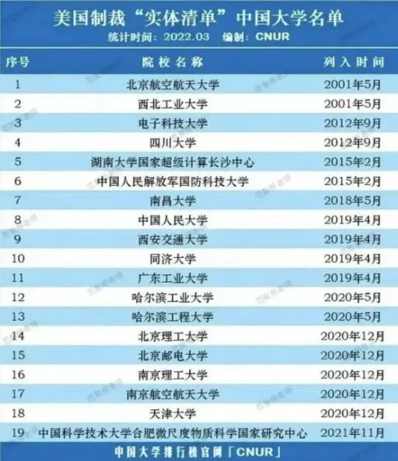
“实体清单”

Slide 111
“实体清单”企业
天津飞腾信息技术有限公司
上海集成电路技术与产业促进中心
深圳市信维微电子有限公司
国家超级计算深圳中心
国家超级计算济南中心
国家超级计算无锡中心
国家超级计算郑州中心
中国航天科技集团公司第九研究院771研究所
中国航天科技集团公司第九研究院772研究所
中国空间技术研究院502研究所
中国空间技术研究院513研究所
中国电子科技集团公司43研究所
中国电子科技集团公司58研究所
珠海欧比特宇航科技股份有限公司

Slide 112

美国对他国的制裁
曾被制裁过的国家
朝鲜、古巴、越南、伊朗、俄罗斯、中国
典型事件
东芝事件，1987年5月27日，日本警视厅逮捕了日本东芝机械公司铸造部部长林隆二和机床事业部部长谷村弘明。 结果：东芝半导体业务持续衰落，曾经全球数一数二的芯片巨头，最终在2018年将其芯片业务出售给美国并购公司贝恩资本，黯然退出芯片制造行业。
阿尔斯通案件，2013年4月14日，皮耶鲁齐赴美公务旅行时被捕，被迫认罪，重罚阿尔斯通7.72亿美元。 结果：2014年，通用电气收购其电力设备业务，将这一世界工业巨头“肢解”。
华为，孟晚舟事件 2018年12月1日，孟晚舟在加拿大温哥华被捕； 被拘押1000多天； 2021年9月25日，乘坐中国政府包机返回祖国。

Slide 113
思考
应对制裁：
把核心技术掌握在自己手中
使自己的国家更强大
军事国防领域的强大
经济、科技、文化各领域的全面强大
“去美元化”：
有些国家为打破美元的霸权优势地位已在尝试。
美国能制裁别国的原因：
掌握核心技术
强大的实力
掌握美元霸权

Slide 114
中国应对——核高基计划，去IOE
核高基
核心电子器件
高端通用芯片
基础软件产品
基础软件
操作系统、数据库和中间件
核高基计划
2006年，国务院发布《国家中长期科学和技术发展规划纲要(2006-2020年)》
16个重大科技专项之一
国之重器：核心技术
解决“卡脖子”问题
提高核心竞争力
去IOE
IBM的小型机
Oracle数据库
EMC存储设备
发展具有自主知识产权、 自主可控的产品， 保障国家IT基础设施的安全。

Slide 115
国之重器：神威•太湖之光
超级计算机，国家并行计算机工程技术研究中心研制，安装在国家超级计算无锡中心。
国家科技实力的重要标志之一
战略高技术领域，世界各国竞相角逐的科技制高点
组成：40运算机柜 + 8网络机柜
每个运算机柜：4块由32块运算插件组成的超节点
每个插件：由4个运算节点板组成
一个运算节点板：2块“申威26010”高性能处理器（中国自主研发）
40960个“申威26010”众核处理器
采用64位自主申威指令系统
峰值性能：12.54京次/秒，世界第三（1京=1亿亿）
持续性能：9.3京次/秒，世界第一
性能功耗比：6051MFlops/W，世界第一
2020年6月，全球超级计算机Top500榜单公布，排名第四。
1分钟的计算能力，相当于72亿人同时用计算器不间断计算32年，
或相当于大约200多万台普通个人电脑。

Slide 116
国之重器：神威•太湖之光
操作系统：RaiseOS 2.0.5
国产系统神威睿思，基于Linux开源代码
主要面向高性能计算和通用计算领域
经过十多年的磨砺，非常成熟
优势：自主可控度高、安全性强
对Linux系统内核进行了全面的剖析，进行了安全性增强和特殊改造
结合申威处理器自主指令系统特点和国产处理器新增安全特性
极大提升了基础硬件平台和核心软件系统的安全性。

Slide 117
国之重器：天河
天河一号：国防科大研制，中国首台千兆次超级计算机，部署在天津的国家超级计算机中心。
2008年开始研制
一期系统（TH-1）于2009年9月研制成功，10月29日，在长沙亮相。
二期系统（TH-1A）于2010年8月在国家超级计算天津中心升级完成。
世界上最节能的超级计算机
世界排名：2010年11月，第一；2012年6月，第五
2019年1月，“天河一号”已连续5年满负荷运行。
天河二号：国防科技大学研制
峰值计算速度：每秒5.49京次
持续计算速度：每秒3.39京次
2013年全球最快超级计算机
2020年6月，全球超级计算机Top500榜单公布，排名第五。

Slide 118
国之重器：天河
操作系统：麒麟Linux，中国自主研发
银河麒麟2.0操作系统完全版包括实时版、安全版、服务器版三个版本。
权威机构进行了源码级鉴定，银河麒麟安全操作系统主要分为三层：
最底层是自己加的内容，主要是为保证安全性、实时性等方面的任务，可自由替换加载。
中间层是 FreeBSD 的内核
最上层是 Linux 兼容库
麒麟操作系统
“天问一号”成功着陆火星使用的操作系统
已经在中国空间站、北斗等领域得到广泛应用

Slide 119
国之重器：助力抗疫
在国家超级计算广州中心，“天河二号”超级计算机就曾建立抗击新冠疫情信息系统和数据库
实现定点医院全部病例数据和临床药物疗效数据的实时采集与在线分析；
实现抗疫医疗质量控制与分析。
在阻断疫情扩散方面，广州超算中心开发的软件，基于已确诊的病患，利用传统流行病调查与大数据追踪分析等手段，结合地理信息技术，构建了新冠病毒肺炎病患时空轨迹数据库。

Slide 120
华为应对——操作系统
鸿蒙操作系统
2019.8.9，在东莞举行华为开发者大会，正式发布鸿蒙OS。
2020.9.10，华为鸿蒙系统升级至华为鸿蒙系统2.0。
2020.12.16，手机鸿蒙系统OS 2.0开放Beta测试版本。
2021.2.22，华为正式宣布HarmonyOS将于4月上线。
2021.3，华为表示，今年搭载鸿蒙操作系统的物联网设备有望达到3亿台，手机将超过2亿台。
EulerOS：基于 CentOS 的企业级 Linux 发行版
OpenEuler：EulerOS 社区版

Slide 121
华为应对——芯片
2019.8.23，在深圳正式发布商用的AI芯片Ascend 910，同时推出全场景AI计算框架MindSpore。
华为自研的达芬奇架构，从IP到指令集都是自研的。
集成了多个CPU、DVPP和任务调度器。
已完成全栈全场景AI解决方案（Portfolio）的构建。
2019.9.20，发布全球首款第二代5G手机-Mate30系列，该型号手机搭载了麒麟990芯片的5G版本。
芯片板面积比三星Exynos小36%，运算效率提高了20%。
2019.10.20，在世界互联网大会发布鲲鹏920处理器
基于ARM Cortex-A76架构，采用7nm工艺制造，可以支持32/48/64个内核，主频可达2.6GHz，支持8通道DDR4、PCIe 4.0和100G RoCE网络。
基于鲲鹏920的TaiShan服务器、华为云服务。

Slide 122
A6: 移动通信--北邮故事
移动计算的基础：移动通信网络
北邮贡献—5G
北邮贡献—代表性工作
我们能做什么？
“助顺邮我”
122

Slide 123
北邮贡献—5G
何同学在北邮拍摄的5G测试视频
北京地区第一个实现5G信号全覆盖的学校
应用：5G智慧迎新、刷脸认证，在2020年的开学季，北邮首次尝试了利用5G进行4K全息投影远程直播授课！
2020.9.16晚，芦鹏飞教授在沙河校区教学楼N215教室上课，借助“5G+全息投影”技术，芦老师的三维全息投影人像同一时刻清晰地呈现在西土城校区教三-335教室。
教室里配备了AI助学机器人，在现场针对课程内容进行了提问互动。
两个特色：（1）凭借5G低时延、高速率特性实现了4K影像实时传输；（2)全息投影带来的全新体验。
5G最显著的三大特征：高速率、低时延、广覆盖。

Slide 124
北邮贡献—6G
2019年11月正式启动和部署6G 研究工作
北邮、东南大学、电子科大等高校以及中国移动、华为等企业均投入到6G前沿领域探索中，力争引领6G使能技术发展。
“现在我们的前面已经没有参照物了，每一个迈向前方的脚步都必须自己摸索！”
继续提升：数据容量、数据传输速度、以及延迟率。
6G网络将向立体空间扩展，覆盖空、天、地、海等所有人类活动的空间区域，并针对任意具有通信需求的情景，利用空域、时域、频域等资源以及接入域、传输域、业务域等网络层次，提供全场景的沉浸式、个性化、极致性能体验。
虚拟现实技术以及无人驾驶技术都将因为6G获得普及机会。

Slide 125
北邮贡献—代表性工作
陈俊亮院士
主持研制中国第一颗“东方红”号卫星的无线信道数据传输系统，获1978年中国全国科学大会奖励。
1960's，主持研制有线600/1200波特及无线600波特数据传输设备，分别获中国全国科学大会奖。
1988，主持项目《DS-2000程控数字电话交换机》，获中国国家科技进步一等奖。
1990's，率先从事智能网研究，主持研制中国第一套智能网系统，其成果已形成产业化并在中国电信网中得到广泛应用，在智能网的软件结构、业务生成、过程控制等方面提出了新方法。

Slide 126
北邮贡献—代表性工作
张平院士
移动通信理论研究及技术创新
提出了TDD高速宽带技术体系方案，为4G技术自主可控走出了第一步； 攻克TDD多模测试技术并研发仪器仪表，填补了全球在此领域的“空白”。
相关成果已应用于5G研发及产业化等
中国5G技术专家、6G技术研发总体专家组专家
廖建新教授
移动通信业务网络。
针对多代并存、复杂异构的移动通信基础网络与丰富多变、差异巨大的业务应用之间智能适配的重大难题，系统性、开拓性地提出移动通信智能业务网络理论和关键技术
主持研制移动智能网、能力智能开放、业务异常智能识别三大智能业务网络核心系统。
“6G全场景按需服务关键技术”
……
2023年5月30日，第三届全国创新争先奖。
中国工程院 2023年 院士增选候选人。

Slide 127
我们能做什么？
5G功能强大，但仍然有许多地方需要完善。
比如：5G 网络管理、控制和运维系统，各自独立、封闭，其安全性、智能性、协同性缺乏全局规划和统一设计，难以满足未来6G沉浸式、个性化的全场景服务和高性能需求。
面向6G按需服务的新一代网络管控体系亟待构建，相关关键技术也亟待突破。
要求我们：
扎实的理论基础
创新意识
实践技能
……

Slide 128
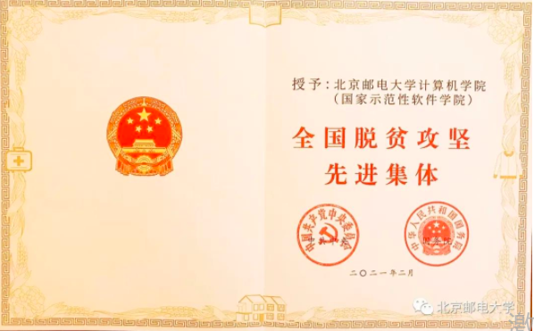
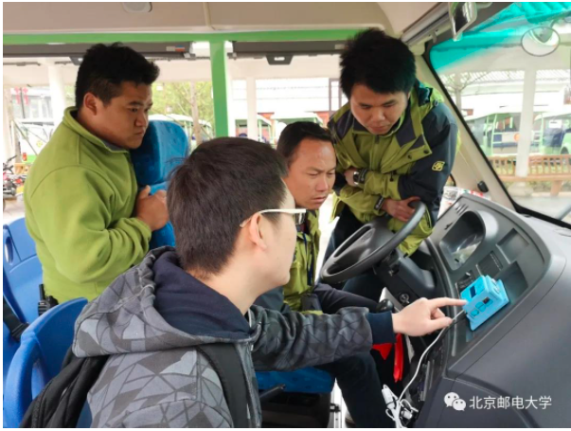
“助顺邮我”科技扶贫
发起：
2017.4，徐萨和几位同学，2015级计科专业本科生
双创项目，学以致用
“长顺扶贫信息平台”，2018.3
“智慧神泉”旅游导览系统，2018.4
提升景区服务软实力，打造长顺更靓丽的“神泉名片”。 项目获得两项国家发明专利，同时参展在京召开的黔南旅游推广大会。 项目2019年5月投入运行。
“农产品产销对接系统”，2019

Slide 129
学以致用的榜样
北邮蓝图创新工作室
喜报

